Slide 1
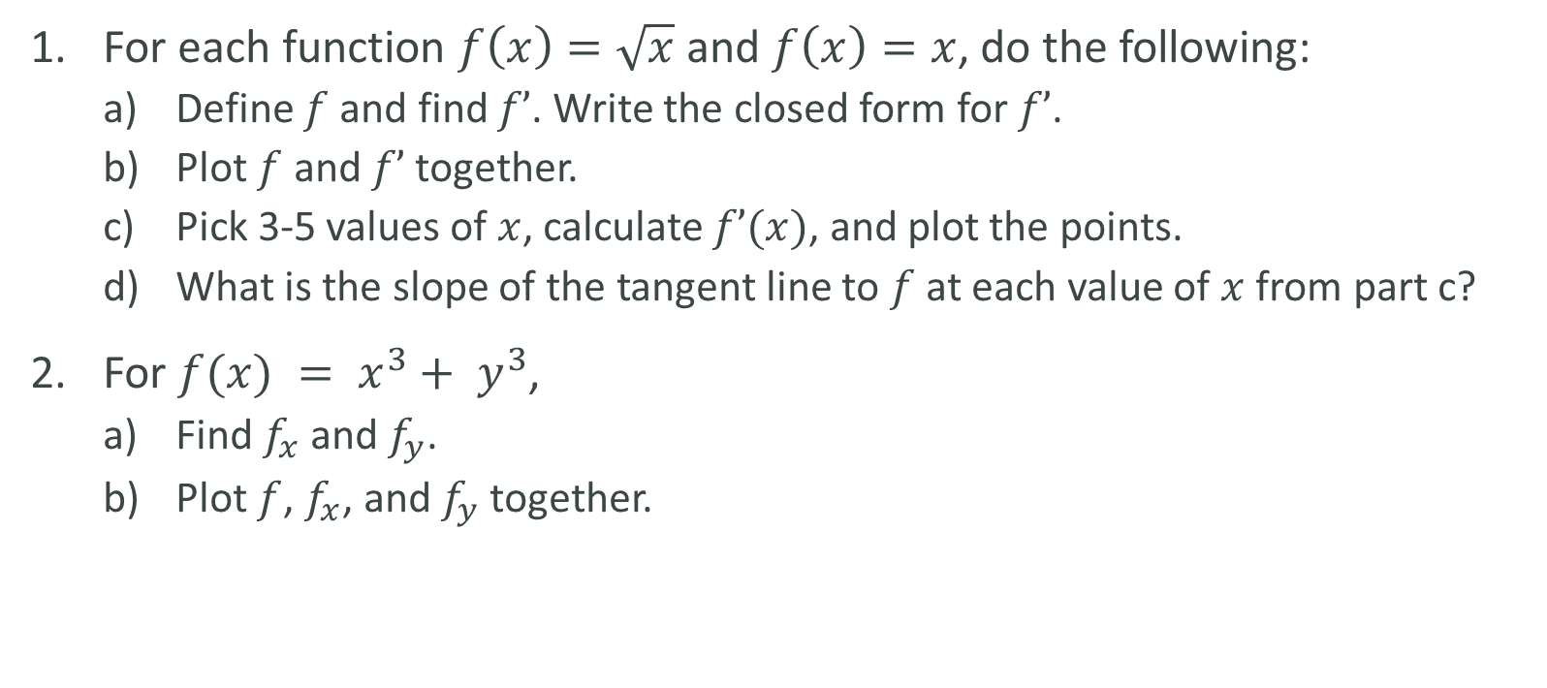
LAB
For each function $f\left(x\right)=\sqrt{x}$ and $f\left(x\right)=x$, do the following:
Define $f$and find $f’$. Write the closed form for $f’$.
Plot $f$ and $f’$ together.
Pick 3-5 values of $x$, calculate $f’(x)$, and plot the points.
What is the slope of the tangent line to $f$ at each value of $x$ from part c?
For $f(x) = x^{3}+ y^{3}$,
Find $f_{x}$ and $f_{y}$.
Plot $f$, $f_{x}$, and $f_{y}$ together.

